Slide 1
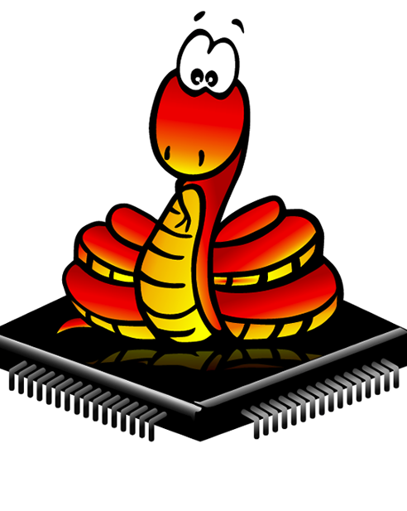
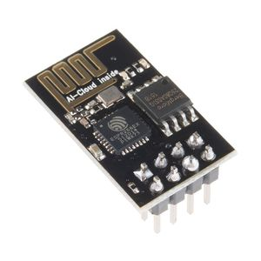

Micropython With ESP8266
for the Internet of Things

Slide 2
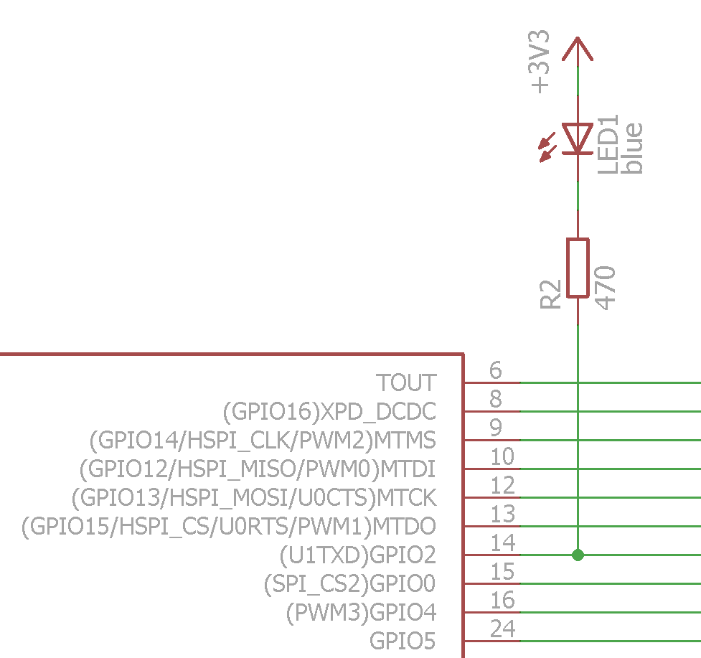
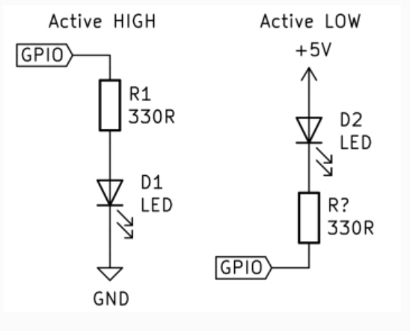
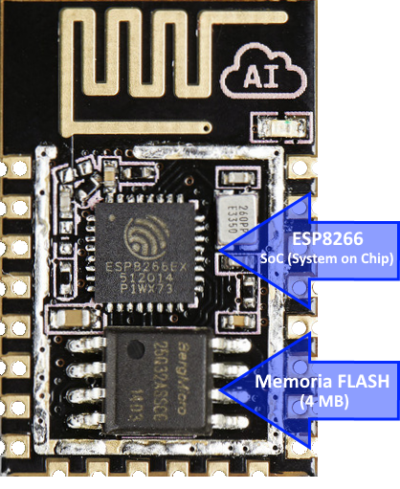
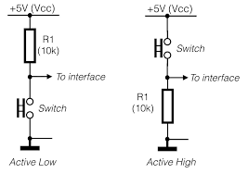











Slide 3
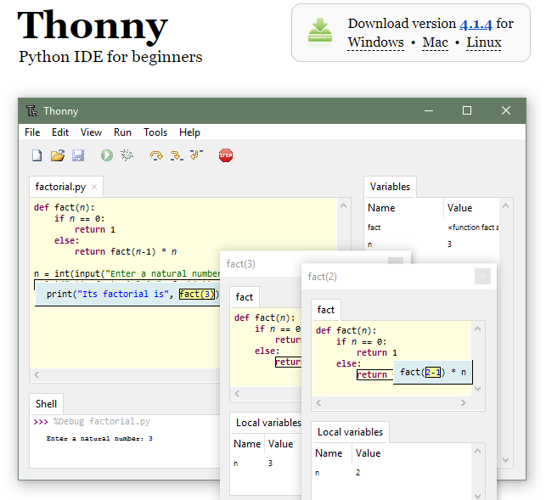
Thonny IDE
https://thonny.org/

Slide 4
The MicroPython Interactive Interpreter Mode (aka REPL)
An acronym for “Read, Eval, Print, Loop”.
This is the interactive Python prompt, useful for debugging or testing code.
a REPL available over a UART, and this is typically accessible on a host PC via USB.
1- Auto-indent
2- Auto-completion
3- Interrupting a running program

Slide 5
THANK YOU

